Slide 1
Mary Wang
Executive Director of Open Chain Project, Linux Foundation
Based in Sweden

Slide 2

Building Trust in the Supply Chain
Since 2016

Slide 3


ISO 5230 & ISO 18974

Slide 4

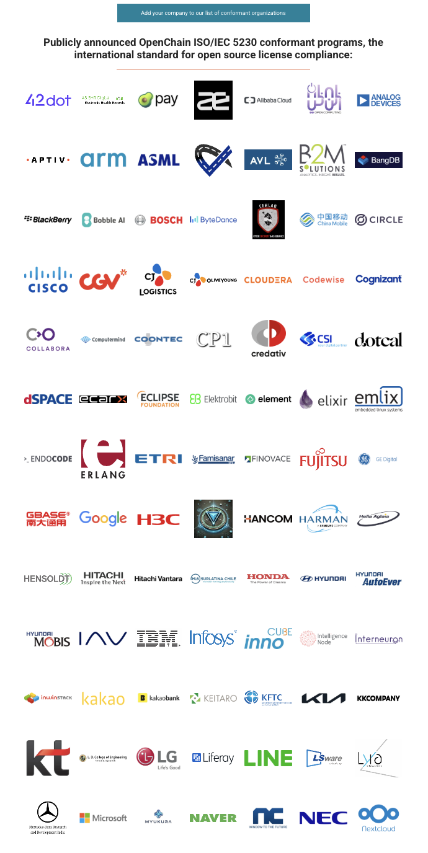
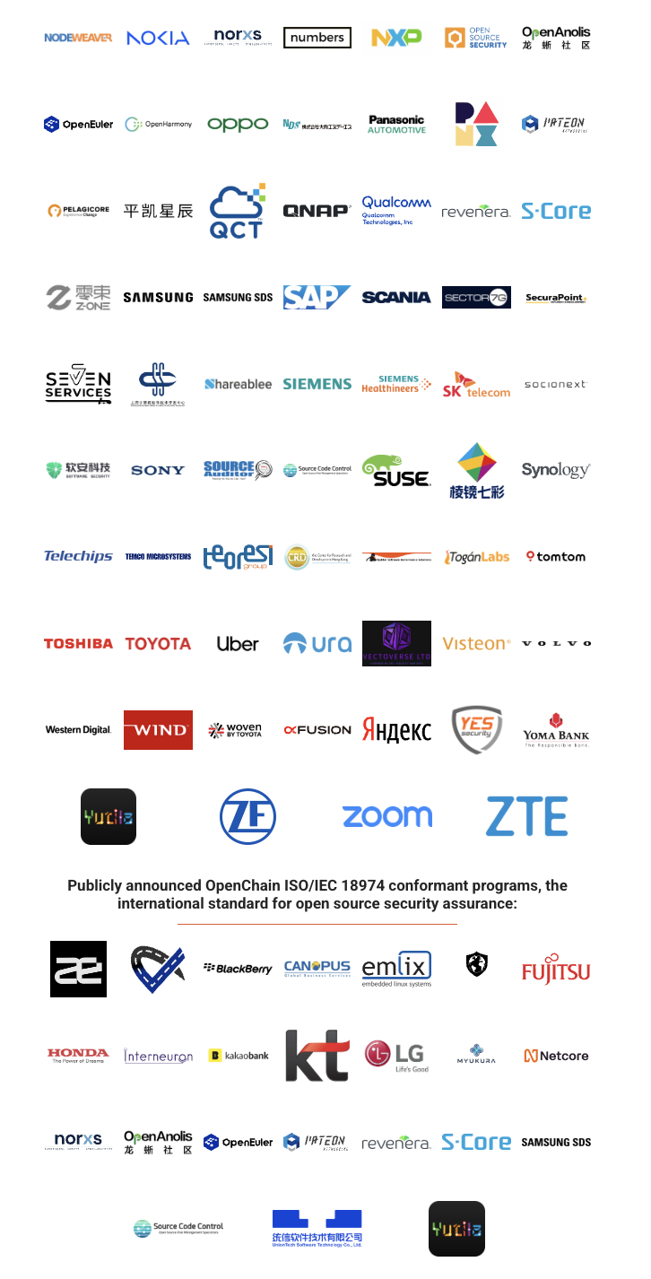
Over 100 companies adopted our standards

Slide 5
OpenChain and all of yours Goal is:
ISO/IEC 5230:2020
Open source license compliance
ISO/IEC 18974:2023
SBOM
(e.g. SPDX file)
Security Assuance compliance
CRA Compliance
SPDX specification
SBOM Resources: https://openchainproject.org/sbom-resources
AI Compliance
2

Slide 6



OpenChain Community
OpenChain Ambassadors:
For more information, please visit:
https://openchainproject.org/community

Slide 7
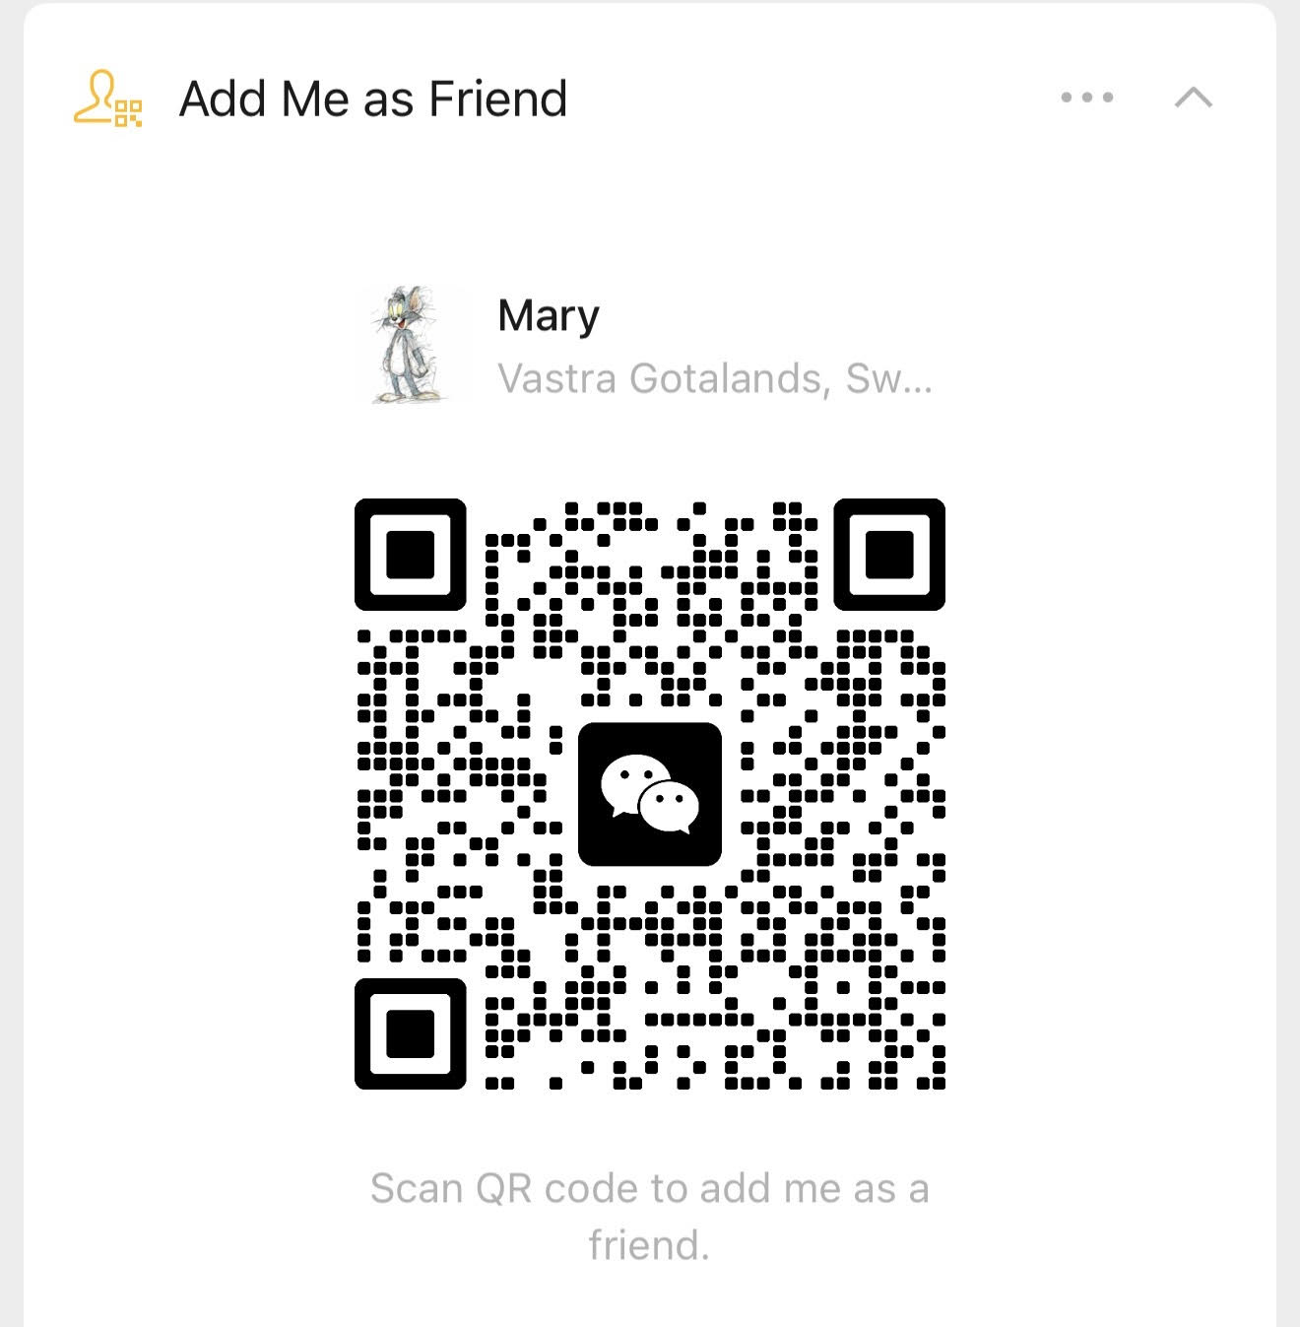
Thank you!
WeChat

